Slide 1

CHAPTER 6
SET THEORY
Copyright © Cengage Learning. All rights reserved.

Slide 2

6.3
Disproofs and Algebraic Proofs
Copyright © Cengage Learning. All rights reserved.

Slide 3
Disproving an Alleged Set Property

Slide 4
Disproving an Alleged Set Property
We know that to show a universal statement is false, it suffices to find one example (called a counterexample) for which it is false.

Slide 5
Example 6.3.1 – Finding a Counterexample for a Set Identity
Is the following set property true?
For all sets A, B, and C, (A − B) ∪ (B − C) = A − C.

Slide 6
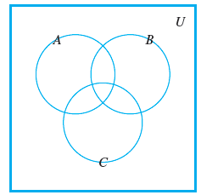
Example 6.3.1 – Solution
Observe that the property is true if, and only if, the given equality holds for all sets A, B, and C.
So it is false if, and only if, there are sets A, B, and C for which the equality does not hold.
One way to solve this problem is
to picture sets A, B, and C by drawing
a Venn diagram such as that shown
in Figure 6.3.1.
Figure 6.3.1

Slide 7
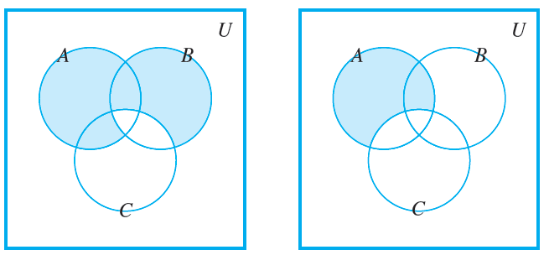
Example 6.3.1 – Solution
continued
If you assume that any of the eight regions of the diagram may be empty of points, then the diagram is quite general.
Find and shade the region corresponding to (A − B) ∪ (B − C).
Then shade the region
Corresponding to A − C.
These are shown in
Figure 6.3.2.
Figure 6.3.2

Slide 8
Example 6.3.1 – Solution
continued
Comparing the shaded regions seems to indicate that the property is false. For instance, if there is an element in B that is not in either A or C then this element would be in (A − B) ∪ (B − C) (because of being in B and not C), but it would not be in A − C since A − C contains nothing outside A.
Similarly, an element that is in both A and C but not B would be in (A − B) ∪ (B − C) (because of being in A and not B), but it would not be in A−C (because of being in both A and C).

Slide 9
Example 6.3.1 – Solution
continued
One way is to put one of the integers from 1 through 7 into each of the seven subregions enclosed by the circles representing A, B, and C.
If the proposed set property had involved set complements, it would also be helpful to label the region outside the circles, and so we place the number 8 there.

Slide 10
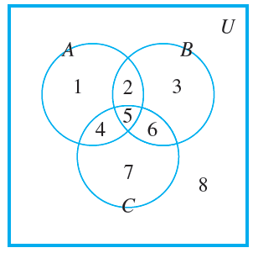
Example 6.3.1 – Solution
continued
(See Figure 6.3.3.) Then define discrete sets A, B, and C to consist of all the numbers in their respective subregions.
Figure 6.3.3

Slide 11
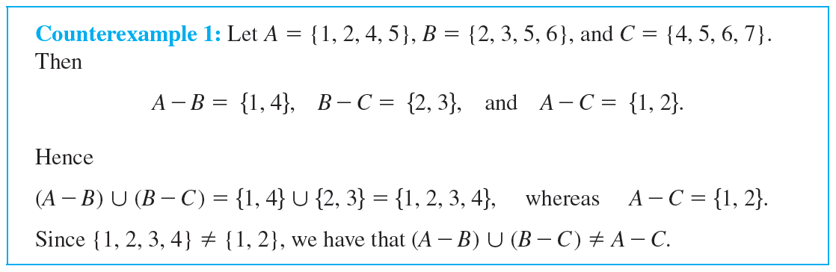
Disproving an Alleged Set Property

Slide 12
Problem-Solving Strategy

Slide 13
Problem-Solving Strategy
How can you discover whether a given universal statement about sets is true or false? There are two basic approaches.
Either you plunge in and start trying to prove the statement, asking yourself, “What do I need to show?” and “How do I show it?” or you try to find a set of conditions that must be fulfilled to construct a counterexample.

Slide 14
Problem-Solving Strategy
With either approach you may have immediate success or you may run into difficulty. The trick is to be ready to switch to the other approach if the one you are working on does not look promising.
For more difficult questions, you may alternate several times between the two approaches before arriving at the correct answer.

Slide 15
The Number of Subsets of a Set

Slide 16
The Number of Subsets of a Set
The following theorem states the important fact that if a set has n elements then its power set has
elements. The proof uses mathematical induction and is based on the following observations. Suppose X is a set and z is an element of X.
1. The subsets of X can be split into two groups: those that do not contain z and those that do contain z.
2. The subsets of X that do not contain z are the same as the subsets of X − {z}.

Slide 17
The Number of Subsets of a Set
3. The subsets of X that do not contain z can be matched up one for one with the subsets of X that do contain z by matching each subset A that does not contain z to the subset A ∪ {z} that contains z. Thus there are as many subsets of X that contain z as there are subsets of X that do not contain z.

Slide 18
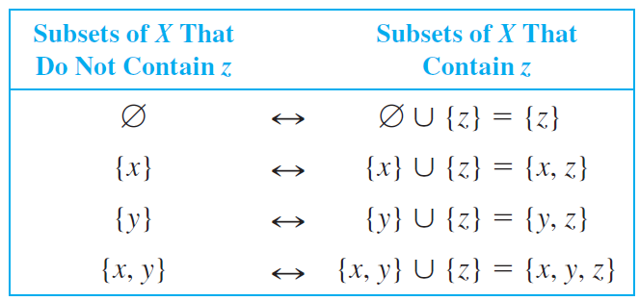
The Number of Subsets of a Set
For instance, if X = {x, y, z}, the following table shows the correspondence between subsets of X that do not contain z and subsets of X that contain z.

Slide 19
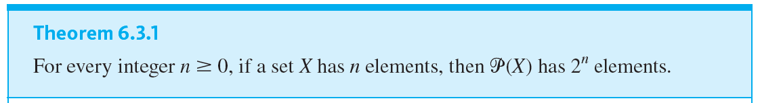
The Number of Subsets of a Set

Slide 20
“Algebraic” Proofs of Set Identities

Slide 21
“Algebraic” Proofs of Set Identities
Let U be a universal set and consider the power set of U, ℘(U). The set identities given in Theorem 6.2.2 hold for all elements of ℘(U).
Once a certain number of identities and other properties have been established, new properties can be derived from them algebraically without having to use element method arguments.

Slide 22
“Algebraic” Proofs of Set Identities
It turns out that only identities (1–5) of Theorem 6.2.2 are needed to prove any other identity involving only unions, intersections, and complements.
With the addition of identity (12), the set difference law, any set identity involving unions, intersections, complements, and set differences can be established.

Slide 23
“Algebraic” Proofs of Set Identities
To use known properties to derive new ones, you need to use the fact that such properties are universal statements. Like the laws of algebra for real numbers, they apply to a wide variety of different situations. Assume that all sets are subsets of ℘(U), then, for instance, one of the distributive laws states that
for all sets A, B, and C, A ∩ (B ∪ C) = (A ∩ B) ∪ (A ∩ C).
This law can be viewed as a general template into which any three particular sets can be placed.

Slide 24

“Algebraic” Proofs of Set Identities
Thus, for example, if A₁, A₂, and A₃ represent particular sets, then
where A₁ takes the place of A, A₂ takes the place of B, and A₃ takes the place of C.

Slide 25
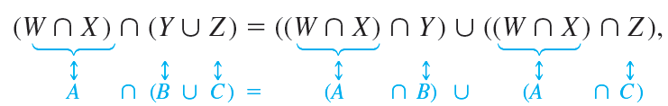
“Algebraic” Proofs of Set Identities
Similarly, if W, X, Y, and Z are any particular sets, then, by the distributive law,
where W ∩ X takes the place of A, Y takes the place of B, and Z takes the place of C.

Slide 26
Example 6.3.2 – Deriving a Set Difference Property
Construct an algebraic proof that for all sets A, B, and C,
(A ∪ B) − C = (A − C) ∪ (B − C).
Cite a property from Theorem 6.2.2 for each step of the proof.

Slide 27




Example 6.3.2 – Solution
Let A, B, and C be any sets. Then
by the set difference law
by the commutative law for ∩
by the distributive law
by the commutative law for ∩
by the set difference law.

Slide 28
Example 6.3.3 – Deriving a Set Identity Using Properties of
Construct an algebraic proof that for all sets A and B,
A − (A ∩ B) = A − B.
Cite a property from Theorem 6.2.2 for every step of the proof.

Slide 29






Example 6.3.3 – Solution
Suppose A, B, and C be any sets. Then
by the set difference law
by De Morgan’s law
by the distributive law
by the complement law
by the commutative law for ∪
by the identity law for ∪
= A − B
by the set difference law.

Slide 30
Example 6.3.4 – Deriving a Generalized Associative Law
Prove that for any sets A₁, A₂, A₃, and A₄,
((A₁ ∪ A₂) ∪ A₃) ∪ A₄ = A₁ ∪ ((A₂ ∪ A₃) ∪ A₄).
Cite a property from Theorem 6.2.2 for every step of the proof.

Slide 31
Example 6.3.4 – Solution
Let A₁, A₂, A₃, and A₄ be any sets. Then
((A₁ ∪ A₂) ∪ A₃) ∪ A₄
= (A₁ ∪ (A₂ ∪ A₃)) ∪ A₄
by the associative law for ∪ with A₁ taking the place of A, A₂ taking the place of B, and A₃ taking the place of C
= A₁ ∪ ((A₂ ∪ A₃) ∪ A₄)
by the associative law for ∪ with A₁ taking the place of A, A₂ ∪ A₃ taking the place of B, and A₄ taking the place of C.

